Slide 1
IS Audit Project
Approach 1: Develop your own small tool.
Munim Siddiqui (20K-1730) Haiman Sher (20K-0296) Eisha Fatima (20K-0383)

Slide 2
Introduction: What is the tool about?
A system auditing tool with multiple key functionalities
Including network information (network interfaces, open ports & connected devices)
File and folder permission checks
System information gathering (hardware, network, memory & software details)
Performs security checks such as examining user accounts & password policies
Installed software retrieval
Timestamps of when the script was run
Error handling

Slide 3
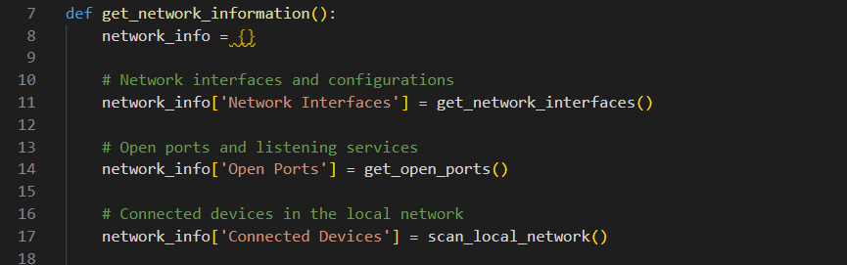
Network information
Collects information about network interfaces, open ports, and connected devices in the local network

Slide 4
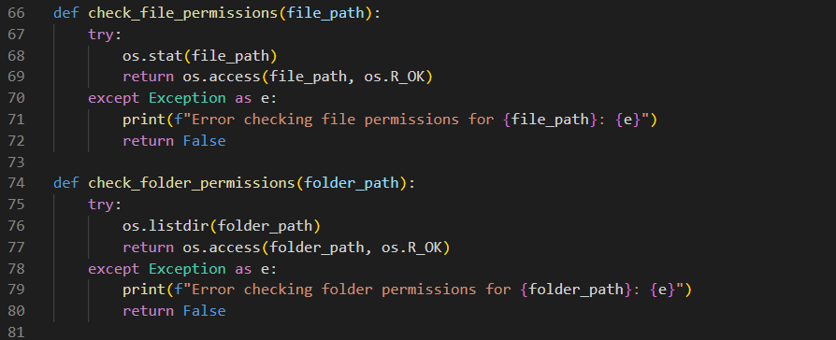
File and folder permissions checks
Ensures that specified files and folders have the necessary read permissions.
Verifies if the script can access critical files and directories

Slide 5
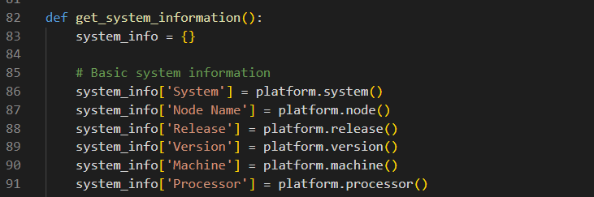
System information gathering
Retrieves comprehensive information about the system
Including basic system details, CPU information, memory information, network information, disk information, software details, security checks, and current time

Slide 6
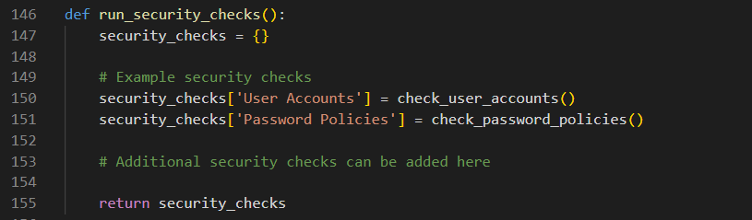
Security checks
Performs security checks on user accounts and password policies

Slide 7
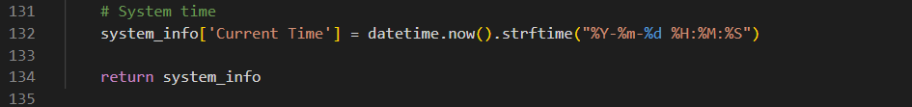
Timestamps
Focuses on capturing the current system time as part of the overall system information
This information can be crucial for correlating the state of the system with specific events or actions

Slide 8
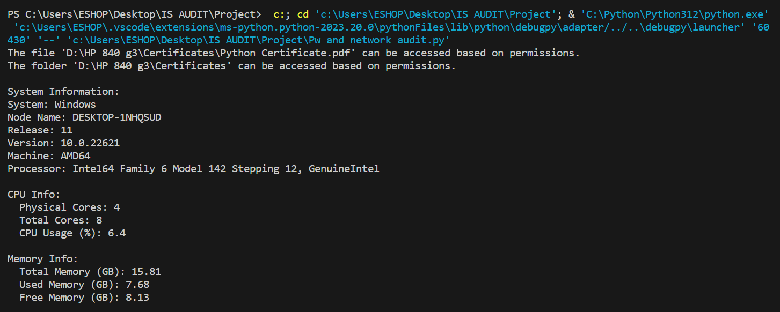
Outputs:
System Info:

Slide 9
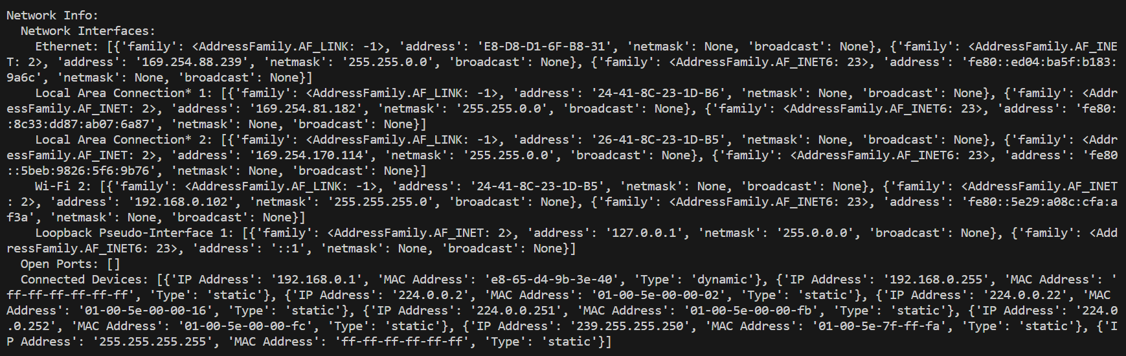
Network Info:

Slide 10
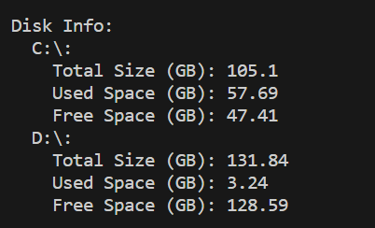
Disk Info

Slide 11
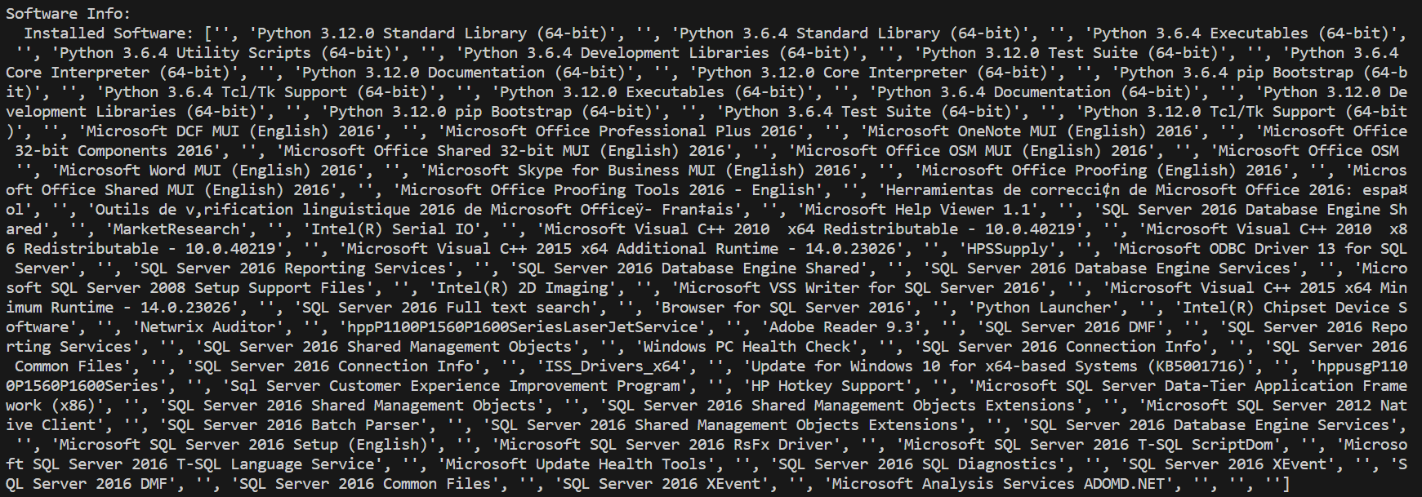
Software Info

Slide 12
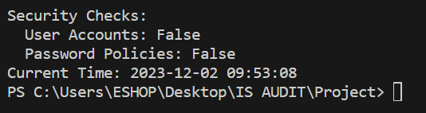
Security check & Time Stamp

Slide 13
Importance and applications of tool
Comprehensive assessment: Holistic analysis of hardware, software and network components
Security compliance: Verifies user accounts, password policies, and adherence to security standards
Network visibility: Identifies open ports, network interfaces and connected devices for vulnerability assessment
Access control assessment: Checks files and folder permissions to ensure proper access controls
Timestamps for audit trails: Records precise timestamps for creating audit trails and correlating events

Slide 14
Conclusion
To sum up, we created an auditing tool based on different functionalities
Provides in-depth insights into system, network and security parameters
Implements automated processes for efficient security assessments
Maintains a timestamped log for accurate incident tracking and accountability
Validates password policies, user account security and compliance standards
Supports IT governance with detailed reporting, troubleshooting and resource analysis

